Slide 1
SKETCH2CODE
The focus nowadays is to use Artificial Intelligence and reduce manual labor. This project will remove the whole user-interface designing and coding phase and hence the developers will be focused on the main functionality of the project. Slight or harsh changes in the interface will be just one click away from our project.
Use of Tensorflow for model development. Furthermore, usage of Amazon Web Services for deployment of REST APIS. Integration of the APIs in a web application for users to interact with
Muhammad Ebadullah Khan (CS-18042)
CGPA – 3.759
Contribution: model deployment, api development, deployment, documentation
Muhammad Huzaifa Abid (CS-18127)
CGPA – 3.166
Contribution: data collection, model training, deployment, api integration, documentation
Farah Yaqoob (CS-18115)
CGPA – 3.581
Contribution: data collection, model deployment, application development, documentation
Muhammad Zain (CS-18125)
CGPA – 3.152
Contribution: data collection, model training, api integration, application development, documentation

Slide 2

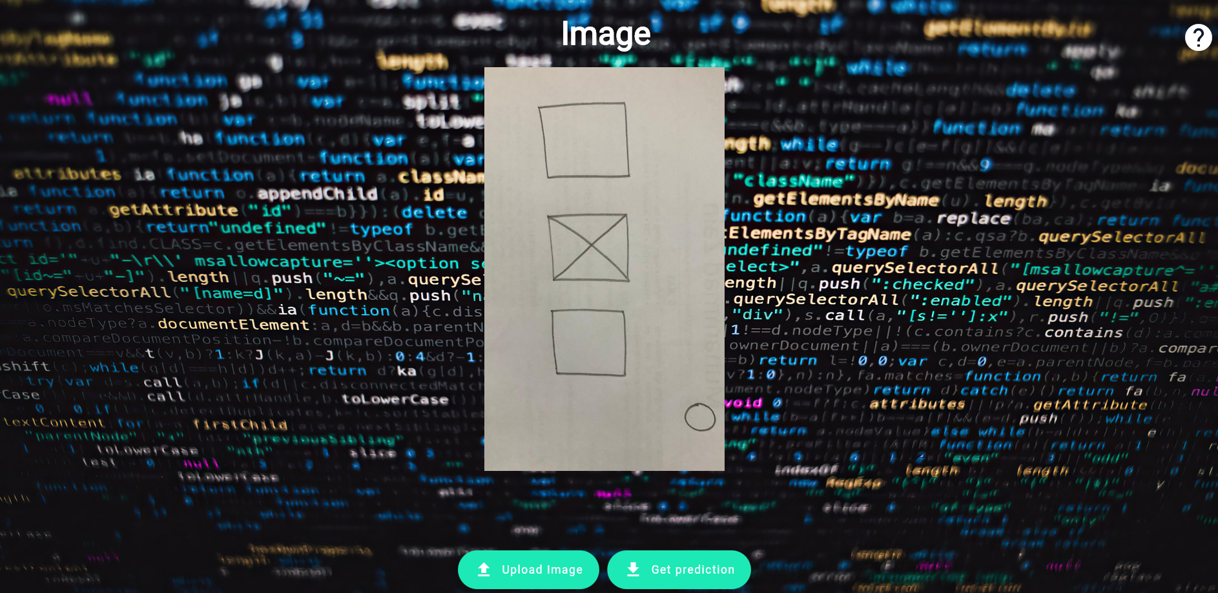




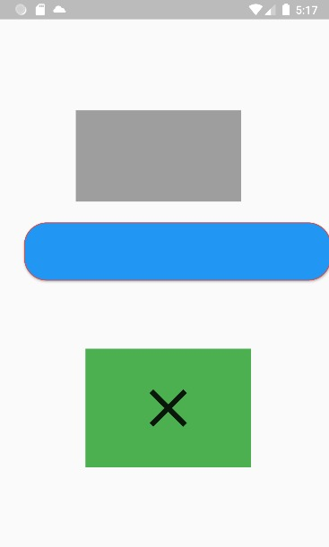
INTRODUCTION
.
.
.
Interactable application
Remove design phase of a project
Generate code automatically
Easily integrable into other applications
Hand drawn sketches
Use of Paint software
Automated processes

Slide 3

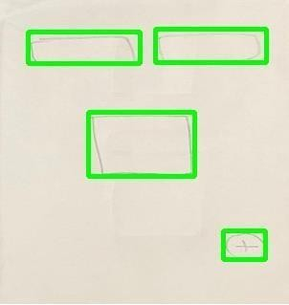







PROJECT FLOW
APPLICATION
EXECUTION ENGINE
DATA
OUTPUT
CLOUD

Slide 4


OVERALL ARCHITECTURE
Development
ML ENVIRONMENT
AWS SAGEMAKER COLAB
Deployment Infrastructure
Model Integration & Prediction
AWS EC2 instance configuration
Security
Networking
Build
Train
Validate
Test
Deploy
Several Projects
Project building
Architecture
Features
Deploy
Integrate
Sketch
Code
Model build, train and test
Pipelines

Slide 5




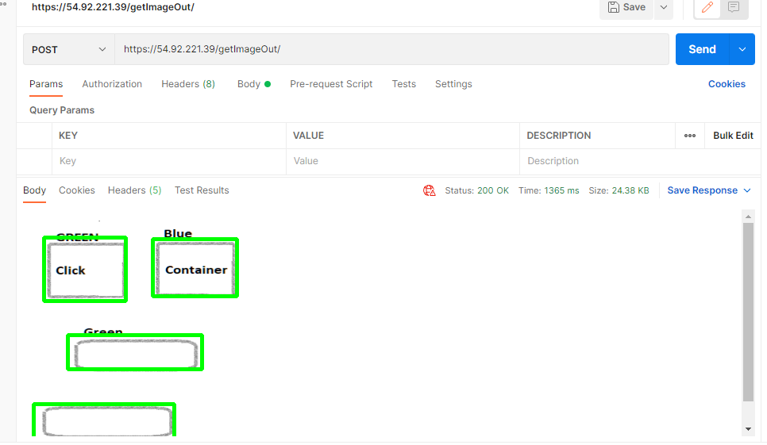

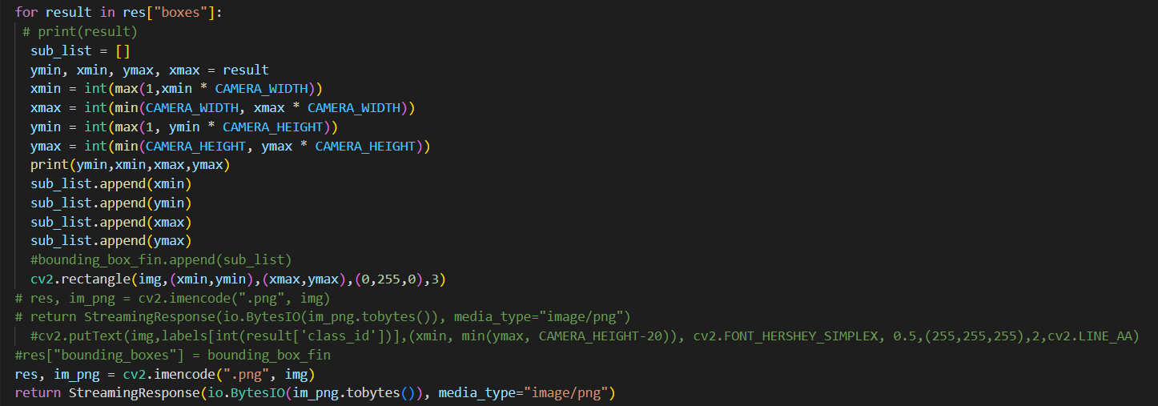
IN DEPTH ARCHITECTURE
AWS
(ubuntu)
TEXT
Cross platform
OBJECTS
Windows
Cross platform

Slide 6
DATA COLLECTION
We draw handwritten sketches manually and collected up to 1500 images.
Images
Floating action button
Container
Text field
Raised button
TARGETED WIDGETS

Slide 7
DATA LABELING AND DATA CLEANING
For labeling of data, we used labeling, and for cleaning of data, we used OpenCV.
LABLEIMG
OPENCV

Slide 8
FEATURES ADDITION
We add 2 more features color detection and text detection.
INPUT IMAGE
OUTPUT IMAGE

Slide 9
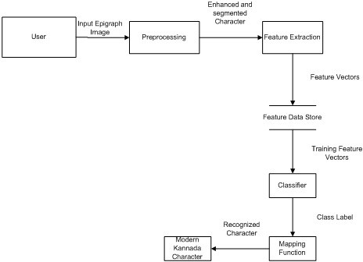
EASY OCR
For color detection and text detection, we used Easy OCR.

Slide 10
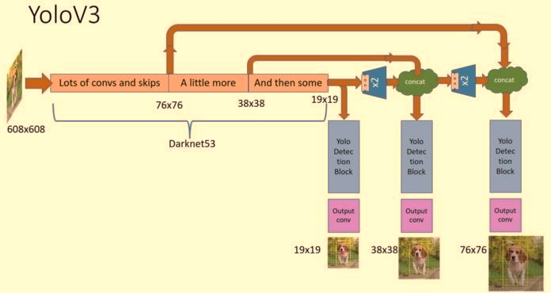
MODEL TRAINING
We used YOLO and TFOD for model training.

Slide 11
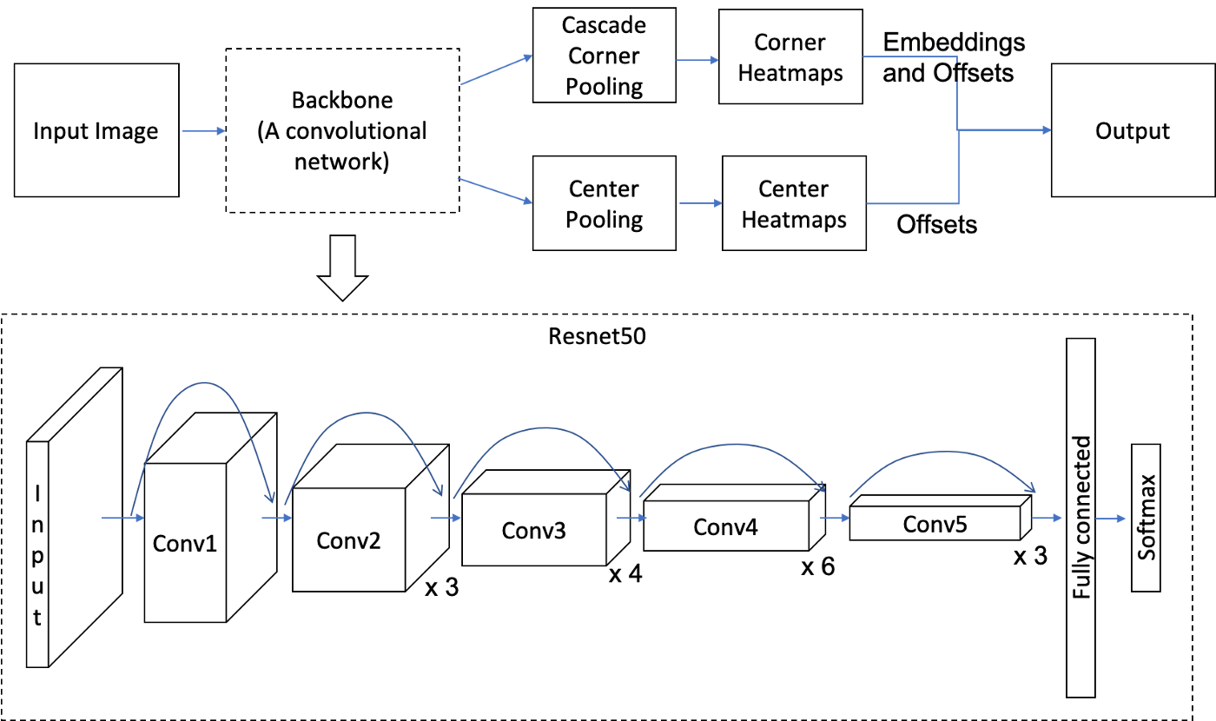
TENSORFLOW OBJECT DETECTION

Slide 12


FAST API
FastAPI is a Web framework for developing RESTful APIs in Python. FastAPI is based on Pydantic and type hints to validate, serialize, and deserialize data, and automatically auto-generate OpenAPI documents. It fully supports asynchronous programming and can run with Uvicorn and Gunicorn.

Slide 13
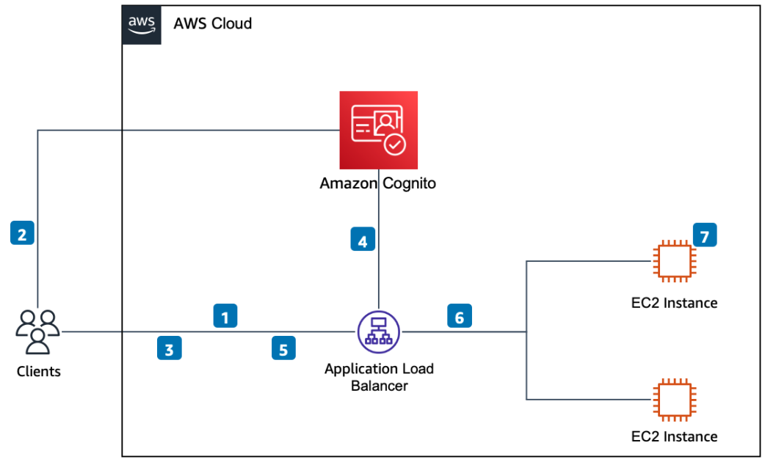
AMAZON WEB SERVICE (AWS)

Slide 14
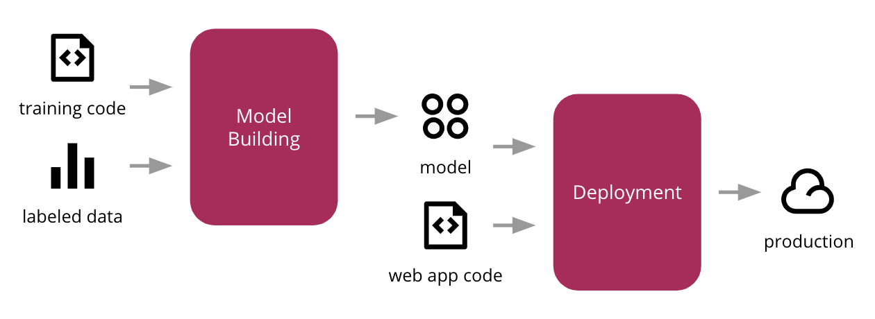
DEPLOYMENT ON AWS

Slide 15

WEB APPLICATION

Slide 16
APPLICATION FLOW
First Screen
Help Screen
Get prediction
Second Screen
See prediction
Download dart code
Alert Dialog
Generate Code

Slide 17
API INTEGRAION
First Endpoint
Second Endpoint

Slide 18
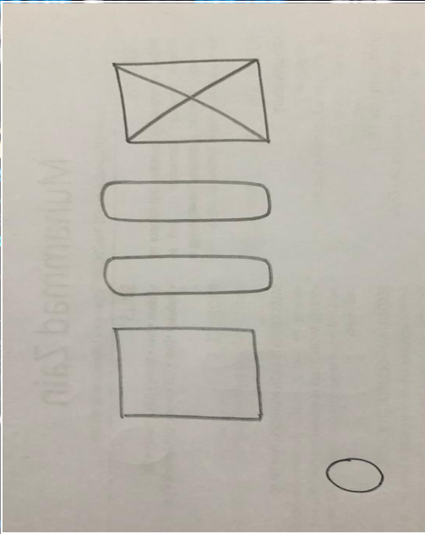
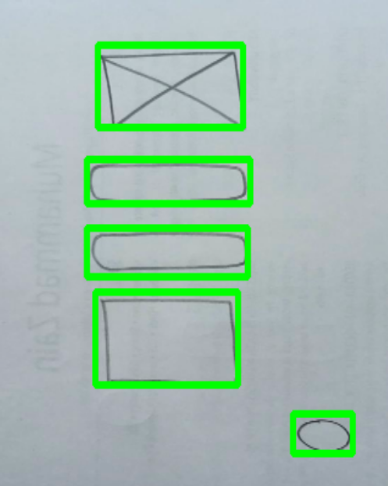
FIRST ENDPOINT
Input Image
Output Image

Slide 19
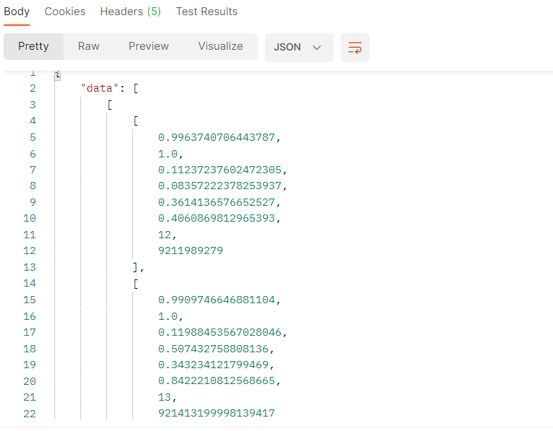
SECOND ENDPOINT
Input Image
JSON Output

Slide 20
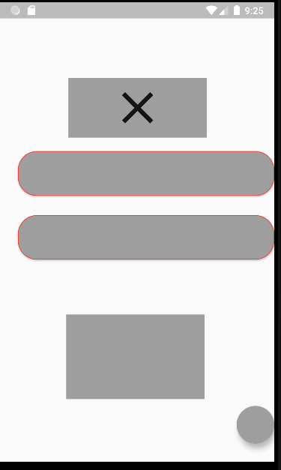
END RESULT
Input Image
Output UI

Slide 21
FUTURE PLANS
Increase number of widgets
Online tool for sketching
More epochs and images for training
More fast and accurate

Slide 22
THANK YOU

